Slide 1
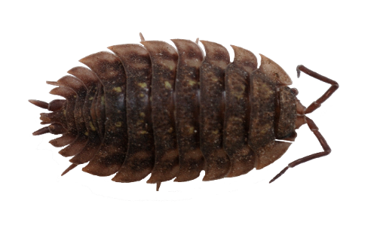
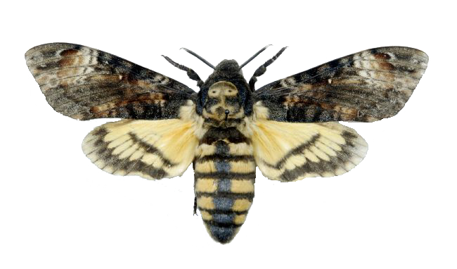
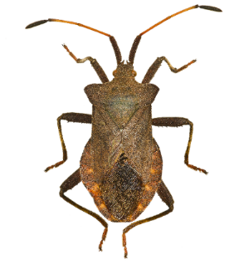
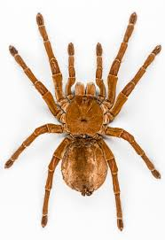
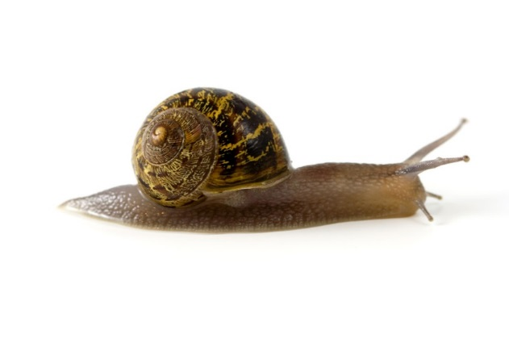
Minibeast Quiz
Are you a minibeast expert?
Do you know your arachnids from your molluscs?
Can you complete the minibeast challenge?
Start

Slide 2
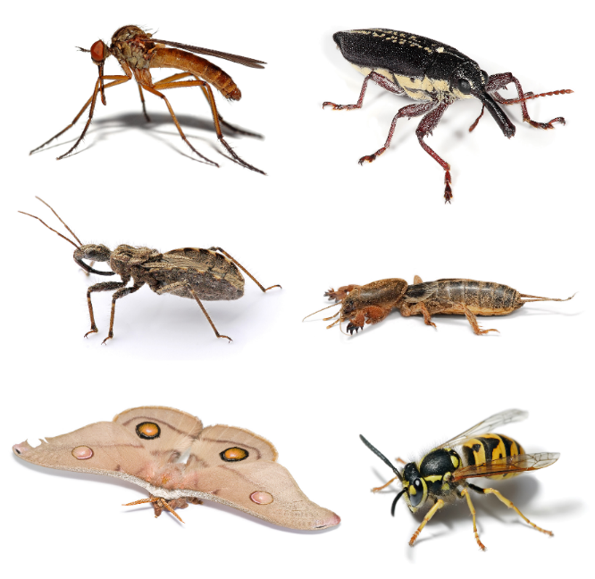
Entomology is the study of insects. True or false?
True
False
^{mylearning.org}

Slide 3
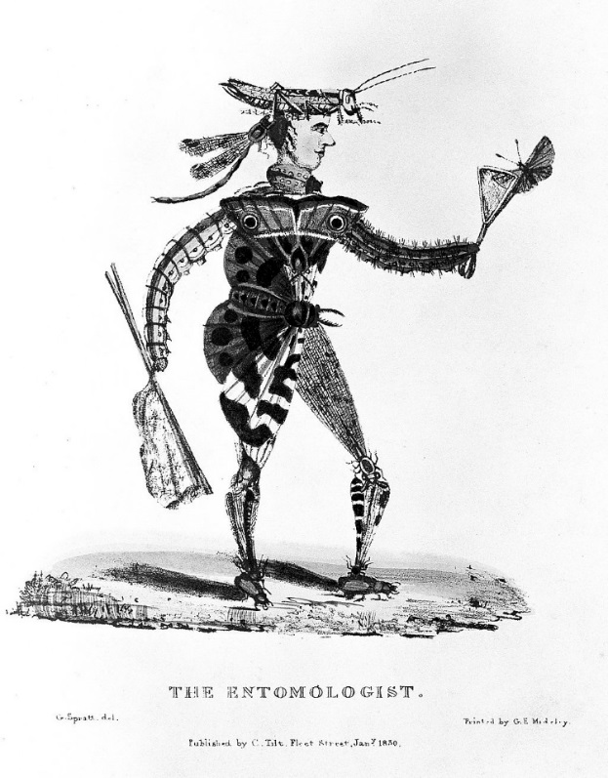
Well done! You are correct.
Someone who studies insects is called an entymologist.
Next
Question
Image: |CC BY 4.0 (http://creativecommons.org/licenses/by/4.0) | Wikimedia Commons
^{mylearning.org}

Slide 4
Incorrect.
Someone who studies insects is called an entymologist.
Next
Question
Image: CC BY 4.0 (http://creativecommons.org/licenses/by/4.0) | Wikimedia Commons
^{mylearning.org}

Slide 5
How many legs do insects have?
8
6
14
^{mylearning.org}

Slide 6
Well done! You are correct.
All insects have
6 legs attached to their thorax
Next
Question
Image: By Bugboy52.40 (Derivative from images uploaded by Fir0002.) [CC BY-SA 3.0 via Wikimedia Commons
^{mylearning.org}

Slide 7
Incorrect.
Look at the pictures to help you and try again!
Back to
Question
Image: By Bugboy52.40 (Derivative from images uploaded by Fir0002.) [CC BY-SA 3.0 via Wikimedia Commons
^{mylearning.org}

Slide 8
Which of these invertebrates is from the arachnid family?
Snail
Butterfly
Spider
Butterfly
^{mylearning.org}

Slide 9
Well done! You are correct.
Spiders are arachnids, along with scorpions.
Next
Question
^{mylearning.org}

Slide 10
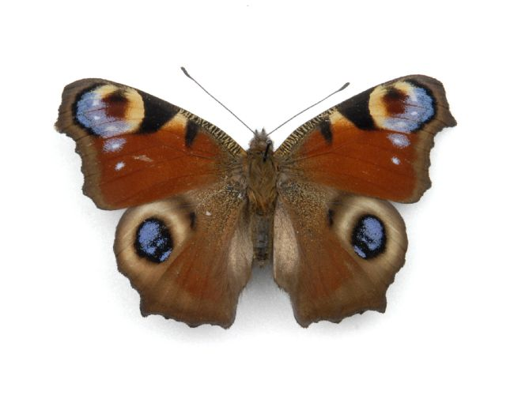
Incorrect
A butterfly is an insect, not an arachnid.
It has only 6 legs, not 8.
Back to
Question
^{mylearning.org}

Slide 11
Incorrect
Snails are molluscs, not arachnids.
They have one foot but no legs.
Back to
Question
^{mylearning.org}

Slide 12
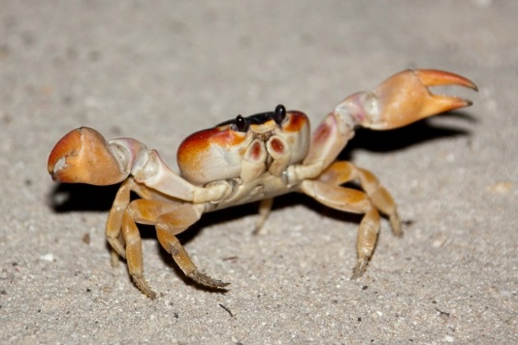
Which of these invertebrates is NOT a crustacean?
Crab
Wood-louse
Snail
^{mylearning.org}

Slide 13
Well done! You are correct.
A snail is not a crustacean.
It is a mollusc.
Next
Question
^{mylearning.org}

Slide 14
Incorrect
A woodlouse is
a crustacean.
Back to
Question
^{mylearning.org}

Slide 15
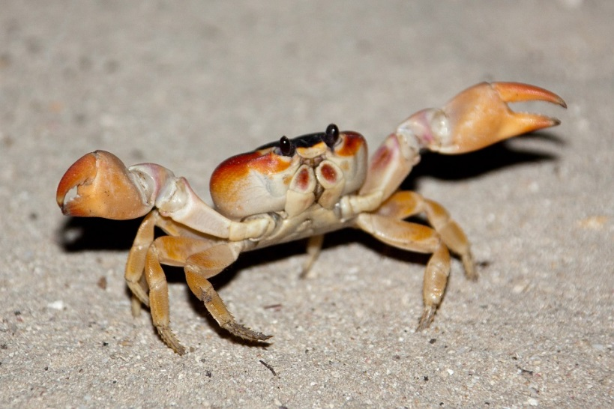
Incorrect
A crab is a
crustacean.
Back to
Question
^{mylearning.org}

Slide 16
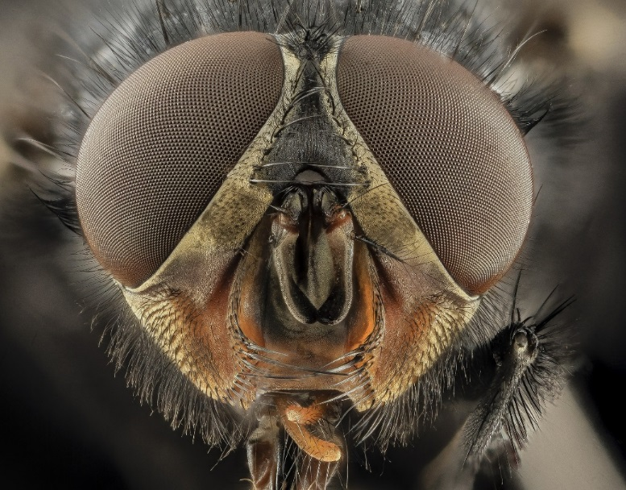
Roughly how many lenses can a fly have on one of its compound eyes?
4,000
4,000,000
4
4,000,000
^{mylearning.org}

Slide 17
Well done! You are correct.
Each of the eyes of a fly is covered in tiny lenses, which means it has excellent vision.
Next
Question
^{mylearning.org}

Slide 18
Incorrect.
No. Flies have lots of lenses on their eyes, but not quite that many!
Back to
Question
^{mylearning.org}

Slide 19
Incorrect.
No. Flies have many more than 4 lenses on their eyes.
Back to
Question
^{mylearning.org}

Slide 20
There is a creature called the ‘bird-dropping caterpillar’. True or False?
False
True
False
^{mylearning.org}

Slide 21
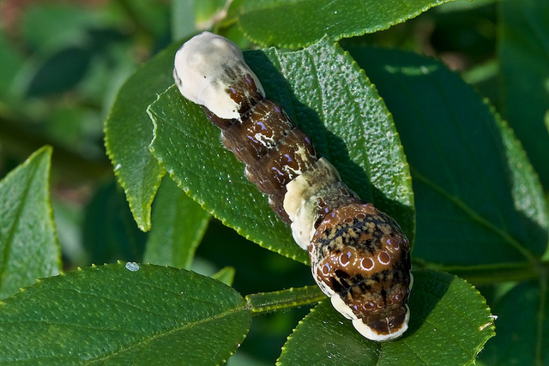
You’re right, it’s true! Check it out below:
The caterpillar looks like bird poop so that other animals don’t want to
eat it.
It’s a defence mechanism.
Next
Question
Image: Distant Hill Gardens | CC BY-NC-SA 2.0 | Flickr
^{mylearning.org}

Slide 22
Incorrect. There is! See below.
The caterpillar looks like bird poop so that other animals don’t want to
eat it.
It’s a defence mechanism.
Next
Question
Image: Distant Hill Gardens | CC BY-NC-SA 2.0 | Flickr
^{mylearning.org}

Slide 23
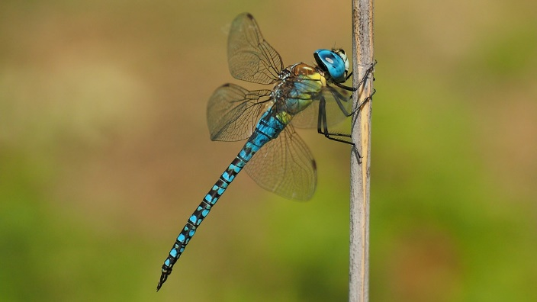
To which part of its body are a dragonfly’s wings attached?
Head
Thorax
Abdomen
4,000,000
^{mylearning.org}

Slide 24
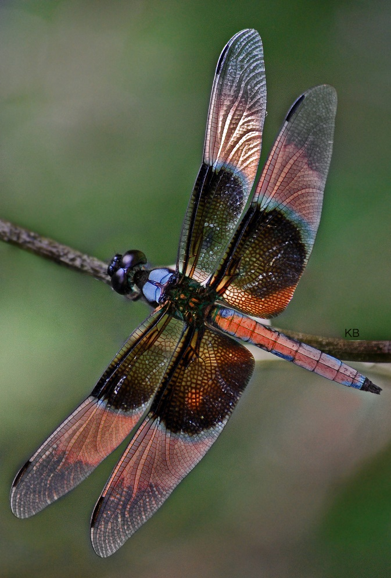
That’s correct.
A dragonfly’s wings are attached to its thorax.
It has four large wings and can move them separately.
This means it is very fast and can change direction very quickly.
Next
Question
Image: PapaLimaWhiskey| CC BY-2.0 | Flickr
^{mylearning.org}

Slide 25
Incorrect.
No, the head contains most of the sense organs like the eyes, mouth parts and antennae.
It does not have the wings attached.
Back to
Question
Image: PapaLimaWhiskey| CC BY-2.0 | Flickr
^{mylearning.org}

Slide 26
Incorrect.
No, the abdomen of a dragonfly is long and aerodynamic for fast flying.
It does not have the wings attached.
Back to
Question
Image: PapaLimaWhiskey| CC BY-2.0 | Flickr
^{mylearning.org}

Slide 27
What does the term ‘myriapod’ mean?
No wings
Shiny
skin
Many-legged one
4,000,000
^{mylearning.org}

Slide 28
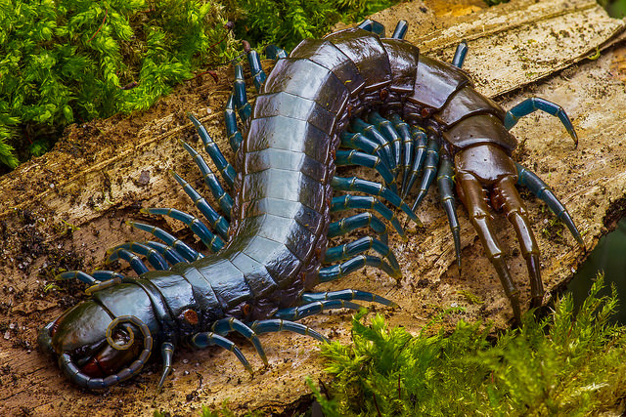
That’s correct.
Centipedes and Millipedes are myriapods because they have lots of legs.
Next
Question
Image: Frupus| CC BY-NC-2.0 | Flickr
^{mylearning.org}

Slide 29
Incorrect.
No, Myriapod does not mean no wings, even though creatures that are myriopods do not tend to have wings.
Have another go!
Back to
Question
^{mylearning.org}

Slide 30
Incorrect.
No, the word ‘myriapod’ has nothing to do with skin.
Try again
Back to
Question
^{mylearning.org}

Slide 31
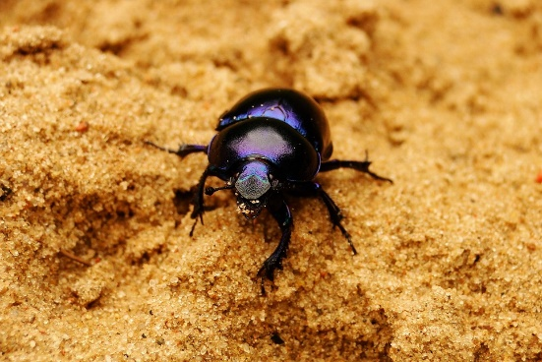
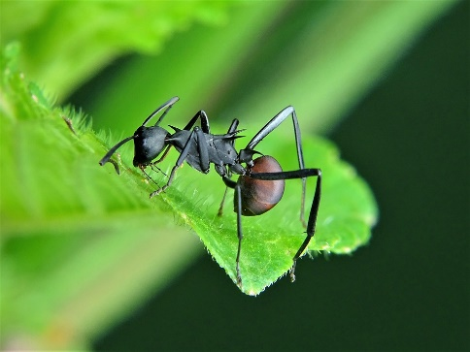
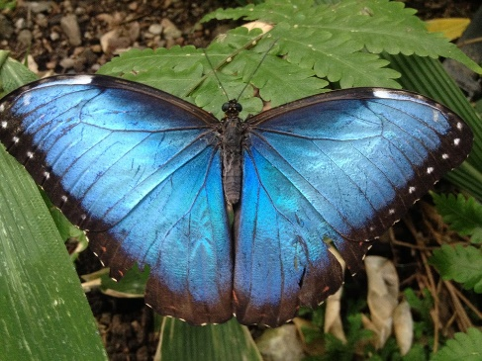
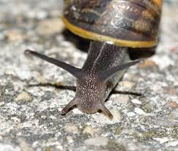
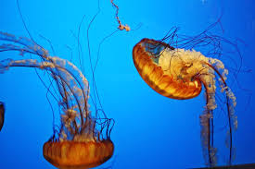
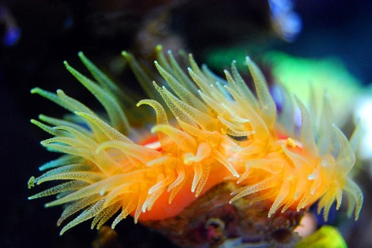
What percentage of creatures on earth are invertebrates?
97%
8%
65%
About…
4,000,000
^{mylearning.org}

Slide 32
That’s correct.
Nearly all living creatures are invertebrates.
They form the largest group by far, with around 40,000 different species in Britain alone!
Next
Question
Image: PapaLimaWhiskey| CC BY-2.0 | Flickr
^{mylearning.org}

Slide 33
Incorrect.
No, the answer is much higher than this. Invertebrates make up most of the creatures on the planet!
Back to
Question
^{mylearning.org}

Slide 34
Incorrect.
No, invertebrates make up even more than 65% of creatures on planet Earth! In fact, they make up nearly all of the creatures in the world.
Back to
Question
Image: PapaLimaWhiskey| CC BY-2.0 | Flickr
^{mylearning.org}

Slide 35
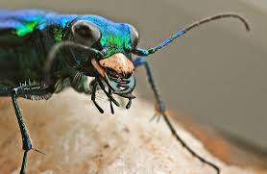
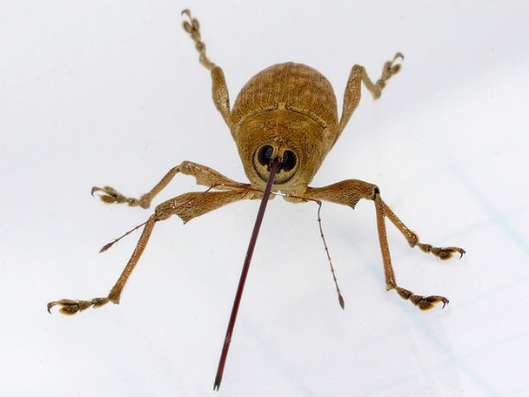
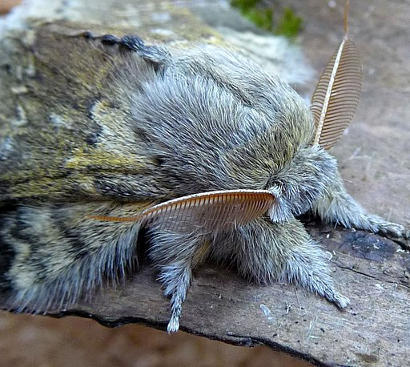
Which of these three minibeasts is a carnivore?
Green tiger beetle
Acorn
weevil
Lobster moth
4,000,000
^{mylearning.org}

Slide 36
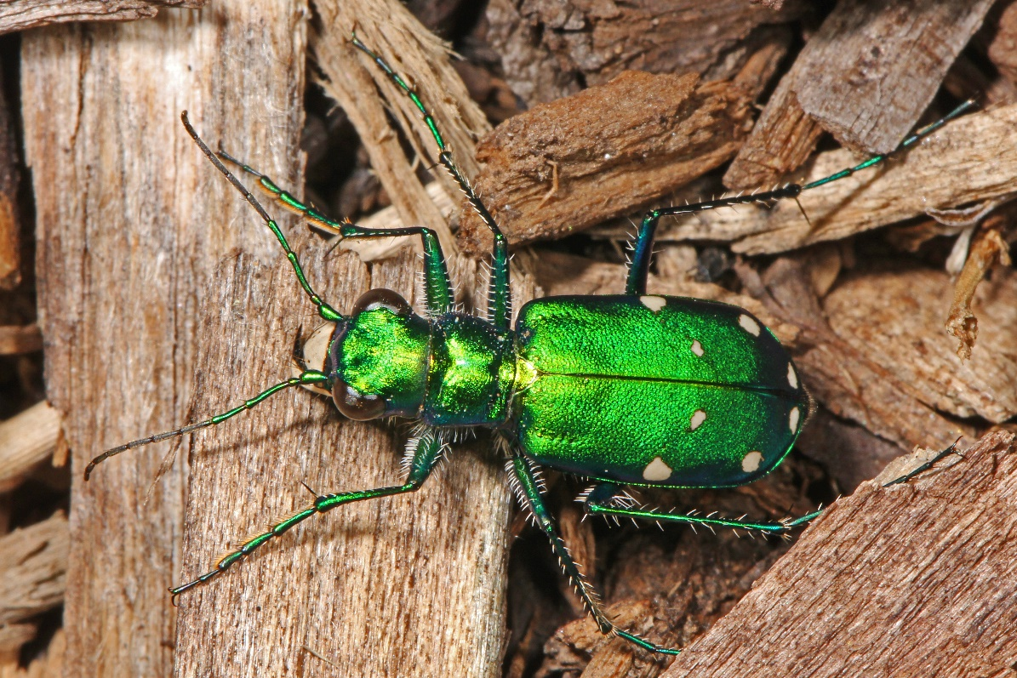
That’s correct.
The green tiger beetle has powerful biting mouth parts for catching and killing prey like ants or small spiders.
END
Image: Judy Gallagher| CC BY-2.0 | Flickr
^{mylearning.org}

Slide 37
Incorrect.
No, this is not a carnivore, it does not eat other creatures.
Try again.
Back to
Question
^{mylearning.org}

Slide 38
Why don’t you check out the minibeasts that live near you ?
You’ll find them in the playground, garden, park, under stones, almost everywhere!
Make sure you treat them carefully, they all have important jobs to do!
Start Again
^{mylearning.org}

